Slide 1
ICT Word Processing Lesson 1: Introduction to Word Processing

Slide 2
Objectives – Lesson 1
7.1.1: Describe the general functions of word-processing software, including benefits for document creation, commonly used word-processing applications.
7.1.2: Define the term "cloud computing," and explain the differences of creating and storing word-processing documents online versus a physical location.
7.1.3: List and describe common word processor interface tools and features.
7.2.2: Identify common keyboard shortcuts used in word processors, and explain the benefits of using shortcuts.

Slide 3
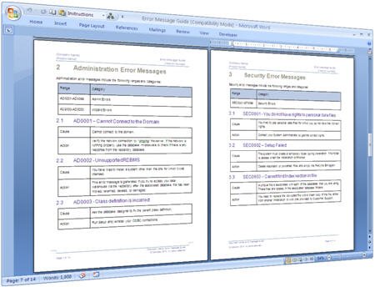
What Is a Word Processor?
Programs that required several other machines – keyboards, monitors, disks, computers, and printers – to create documents.
Give users the ability to:
Correct your work before printing.
Check for spelling and grammar errors.
Verify the meanings of words and synonyms by using the thesaurus.
Transfer text between documents.
Format text with various fonts, sizes and styles.
Format pages instantly with structural styles, such as lists, tables, paragraphs, and headings

Slide 4
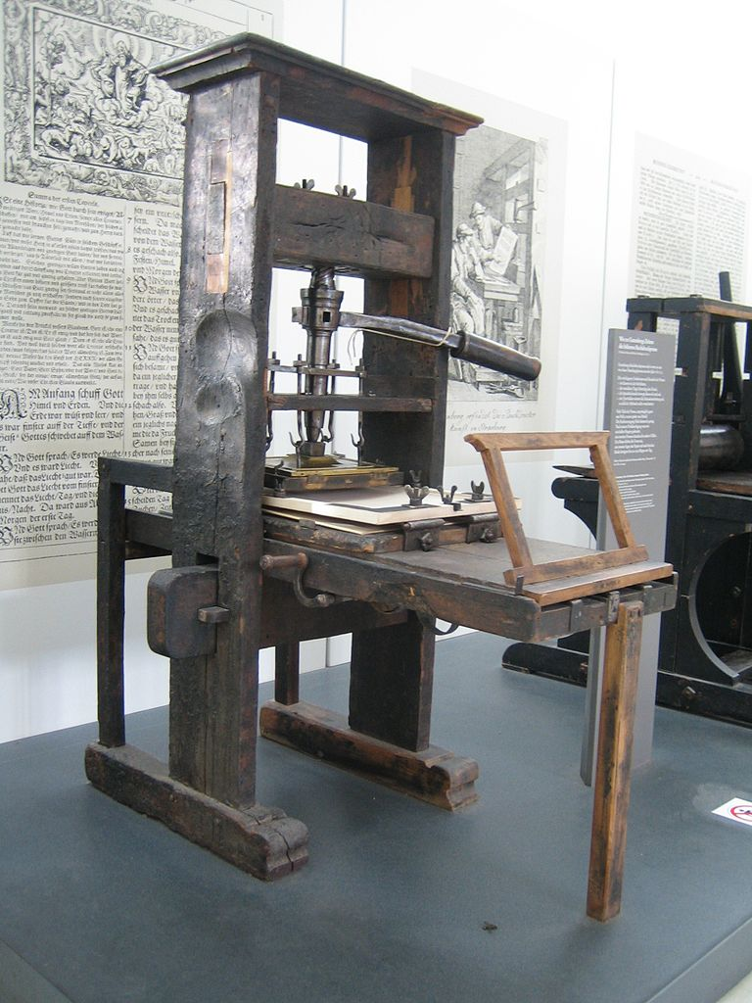
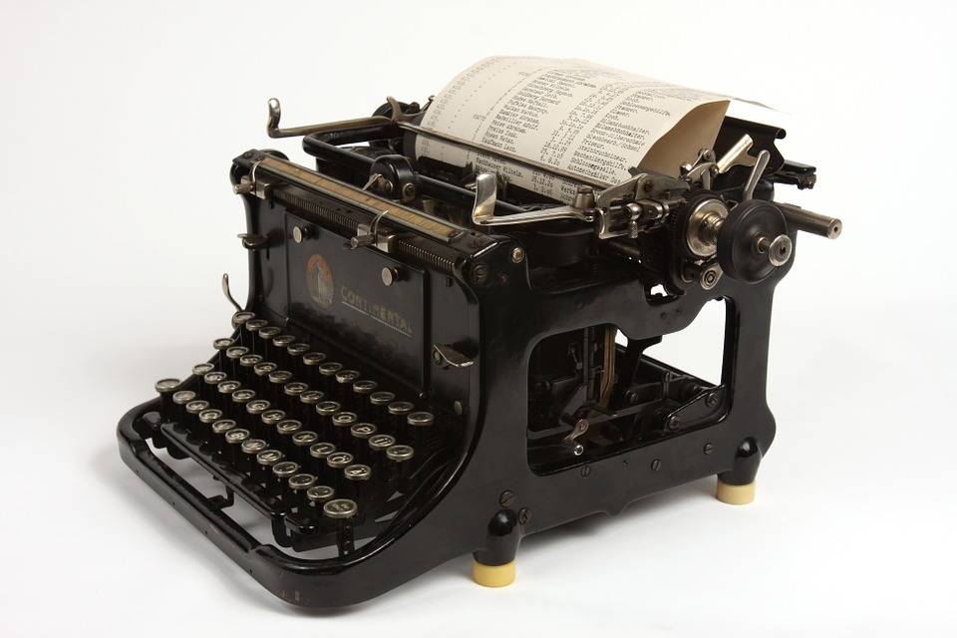
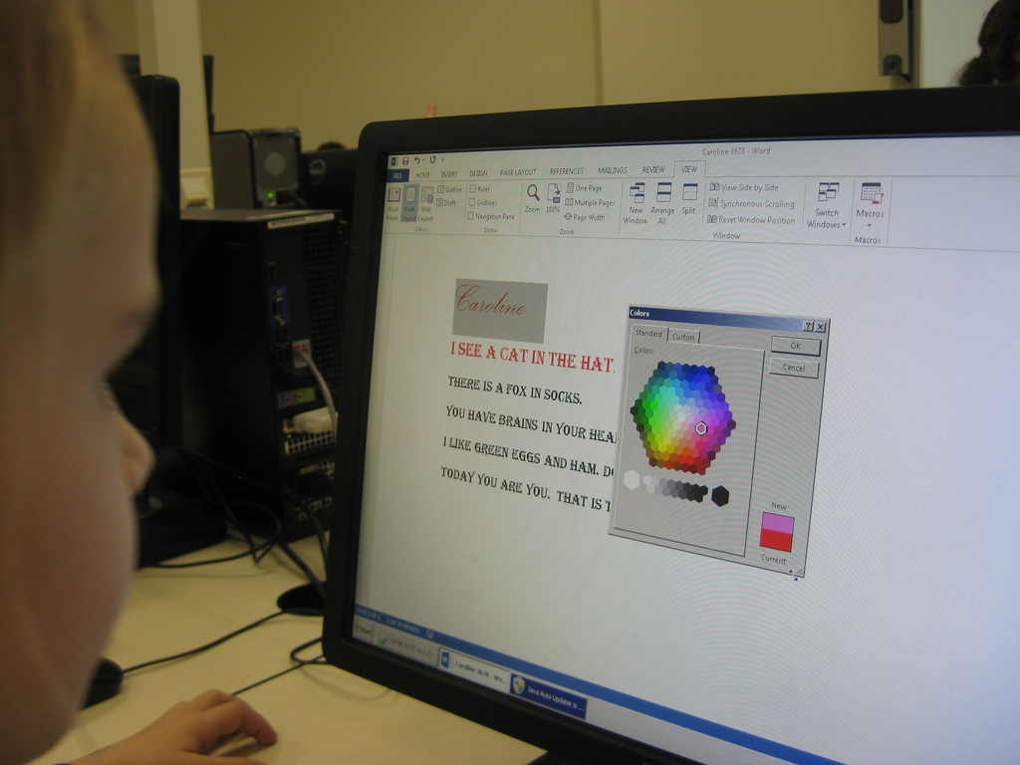
The Beginning of the Word Processor
Started with users writing by hand on different kinds of paper
Then, the first printing press was introduced
Next, came the invention of the typewriter
Finally, in the 1970s the word processor was introduced

Slide 5
Creating Documents
Users can easily create pre-made documents using a:
template - provides a page design layout into which you can place your content.
Allows you to enter your own text and images.
Or you can start with a blank document
Popular software applications which allow you to create documents are Microsoft Word and Google Docs (cloud-based)

Slide 6
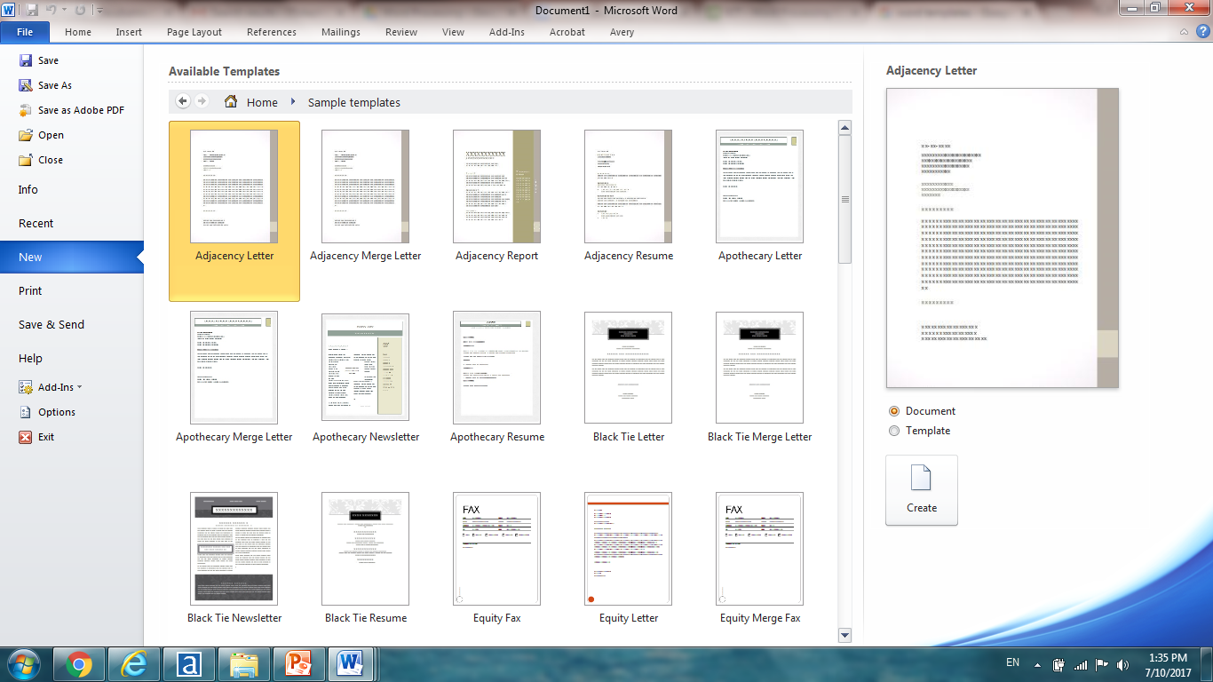
Sample Templates

Slide 7
Storing Your Documents
To the Cloud:
Provides accessibility to your documents from anywhere you can obtain an internet connection.
Provides connectivity from your computer, smartphone or tablet – through downloaded apps for mobile devices.
To the Computer:
Provides a physical location to store documents to a hard drive
Provides exclusive access to information on your computer anytime
Not vulnerable to unsecure documents being hacked or stolen

Slide 8
Cloud Computing
To understand Cloud computing, you must first know what the “cloud” is?
The cloud is a wide network of data centers (made up of large storage computers called file servers) throughout the world that can store your information and retrieve it for you from anywhere you can obtain an Internet connection.
Cloud Computing tools that are used and accessed exclusively over the Internet rather than installed on a single computer.

Slide 9
Let’s Watch the Video
How to Access Google Drive & Microsoft OneDrive
Click Here
Notes:
Discuss types of connections – “Connecting to the Internet” video

Slide 10
Getting Started with Word Processing
When opening a new document in Google Docs, there is a menu of commonly used commands:
Menu | Drop-Down Options
File | Share, New, Open, Rename, Make a Copy, Move to Trash, See Revision History, See New Changes, Language, Download as, Publish to Web, E-Mail Collaborators, Page Setup, Print
Edit | Undo, Redo, Cut, Copy, Paste, Web Clipboard, Select All, Find and Replace
View | Print Layout, Mode (Editing, Suggesting, Viewing), Show Ruler, Show Equation Toolbar, Show Spelling Suggestions, Compact Controls, Full Screen
Insert | Image, Link, Equation, Drawing, Table, Comment, Footnote, Special Characters, Horizontal Line, Page Number, Page Count, Page Break, Header, Footer, Table of Contents
Format | Bold, Italic, Underline, Strikethrough, Superscript, Subscript, Font Size, Paragraph Styles, Align, Line Spacing, Lists, Clear Formatting, Lines, Crop Image, Image Options, Replace Image, Reset Image, Alt Text
Tools | Spelling, Research, Define, Word Count, Voice Typing, Translate Document, Script Editor, Preferences, Personal Dictionary
Table | Insert Table, Insert row above, Insert row below, Insert Column Left, Insert Column Right, Delete Row, Delete Column, Delete Table, Merge Cells, Unmerge Cells, Table Properties
Add-ons | Get Add-ons, Manage Add-ons
Help | Search Menus for Assistance, Docs Help, Report a Problem, Report abuse/copyright, Keyboard Shortcuts

Slide 11
Let’s Watch the Video
How to Open Google Docs & Microsoft Word
Click Here
Notes:
Discuss types of connections – “Connecting to the Internet” video

Slide 12
Common Commands in Microsoft Word
When opening a new document in Microsoft Word 2013, there is a menu of commonly used commands:
Tab | Command Categories
File | Info, New, Open, Save, Save As, Save as Adobe PDF, Print, Share, Export, Close, Account, Options, Add-ins
Home | Clipboard, Font, Paragraph, Styles, Editing
Insert | Pages, Tables, Illustrations, Add-ins, Media, Links, Comments, Header & Footer, Text, Symbols, Flash
Design | Document Formatting, Page Background
Page Layout | Page Setup, Paragraph, Arrange
References | Table of Contents, Footnotes, Citations & Bibliography, Captions, Index, Table of Authorities
Mailings | Create, Start Mail Merge, Write & Insert Fields, Preview Results, Finish
Review | Proofing, Language, Comments, Tracking, Changes, Compare, Protect, Ink
View | Views, Show, Zoom, Window, Macros

Slide 13
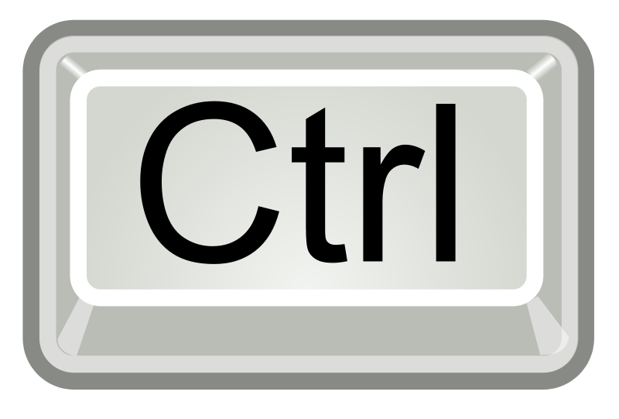
Keyboard Shortcuts
Some common commands are used in word processing to save time and work faster when writing documents. Below are some examples
Open a File = +
Bolding Text = +
Finding Text = +
Copying Text = +
Pasting Text = +
O
Z
Undo = +
Select All = +
Cut Text = +
New File = +
Save a File = +
Print a File = +
A
B
X
F
N
C
S
V
P

